Slide 1




NEXT GEN EMPLOYABILITY PROGRAM
Creating a future-ready workforce
Team Members
College Name
Student Name : SRI RANJANI S
Student ID : 622021104109
PAAVAI COLLEGE OF ENGINEERING-6220

Slide 2

CAPSTONE PROJECT SHOWCASE
Project Title
Building Bus Reservation System using Python and Django
Abstract | Problem Statement | Project Overview | Proposed Solution | Technology Used | Modelling & Results | Conclusion

Slide 3
Abstract
Developed using Django, SQLite, and Python, the Bus Reservation System is a fundamental solution crafted to streamline the process of online ticket purchasing for buses.
Its primary function is to offer users an easy-to-use platform for booking bus tickets online.
Through this system, users can efficiently manage reservations, store client information, and maintain passenger lists.
The administrative tasks such as reservation management, client data handling, and passenger list maintenance are conveniently executed through the Django admin interface.
With the Bus Reservation Website, users can effortlessly book their tickets, enhancing the overall user experience.
Source :https://projectworlds.in/bus-reservation-system-project-python-django/

Slide 4
Problem Statement
In today's hectic world, purchasing bus tickets can be arduous and time-consuming. The outdated ticketing process often involves enduring long lines, filling out paperwork manually, and struggling to find convenient booking locations. Additionally, the absence of a unified ticketing platform exacerbates the inconvenience for both passengers and bus companies.
Long queues
Manual forms
Limited accessibility
Fragmented booking
Time-consuming process
Source :

Slide 5
Project Overview
User Registration and Authentication: Allow users to create accounts and securely authenticate themselves to access the reservation system.
Bus Route Management: Implement a comprehensive system to manage bus routes, including adding, editing, and deleting routes.
Ticket Booking: Enable users to search for available buses based on routes, dates, and timings, and book tickets seamlessly through the web interface.
Seat Selection: Provide an interactive seat selection feature allowing users to choose their preferred seats on the bus.
Source :

Slide 6
Proposed Solution
.
Web-based platform for easy access
Centralized booking system for convenience
Real-time updates for accurate information
Django's authentication for security
Intuitive user interface for enhanced experience
Source :

Slide 7
Seat selection feature for personalization
Secure payment gateway integration
Admin panel for effective management
Scalable infrastructure for reliability
Continuous testing for optimization.
Source :

Slide 8


Technology Used
Front-end
Back-end
Source :

Slide 9
Modelling & Results
User Model:
Regestration
Username
Email
Password
Methods:
Authentication methods
Bus Model:
1.Bus Name
2.Bus ID
3.Route Model:
1.Origin
2.Destination
4.Reporting Model:
1.Booking statistics
2.Amount
3.Time
Source :

Slide 10
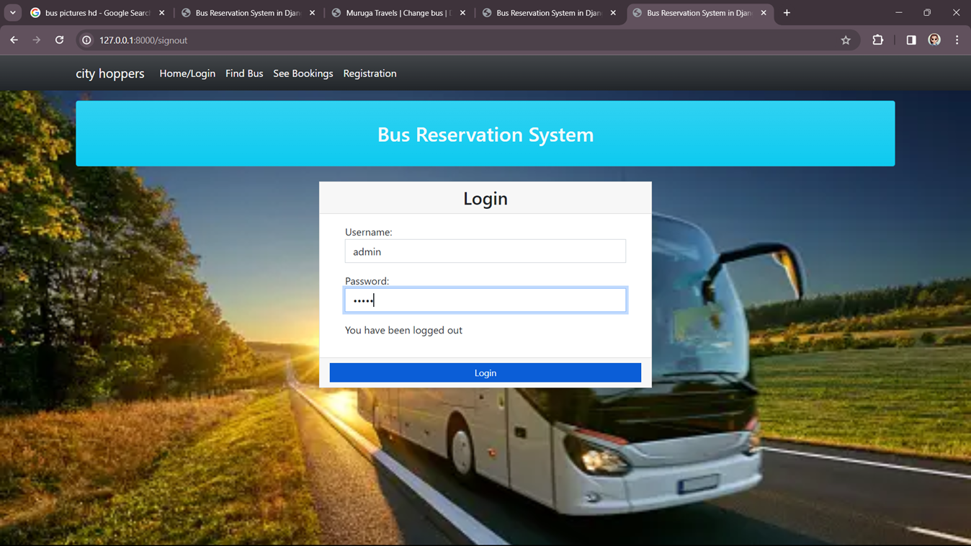
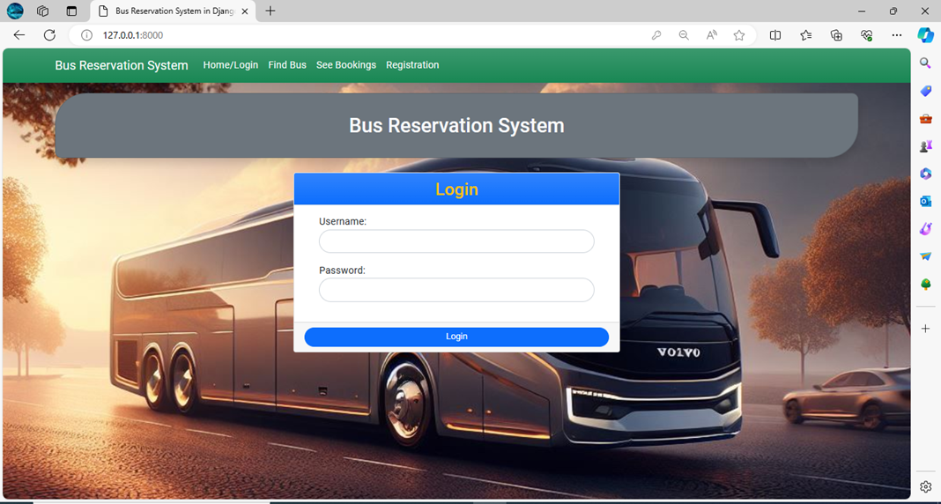
Homepage

Slide 11
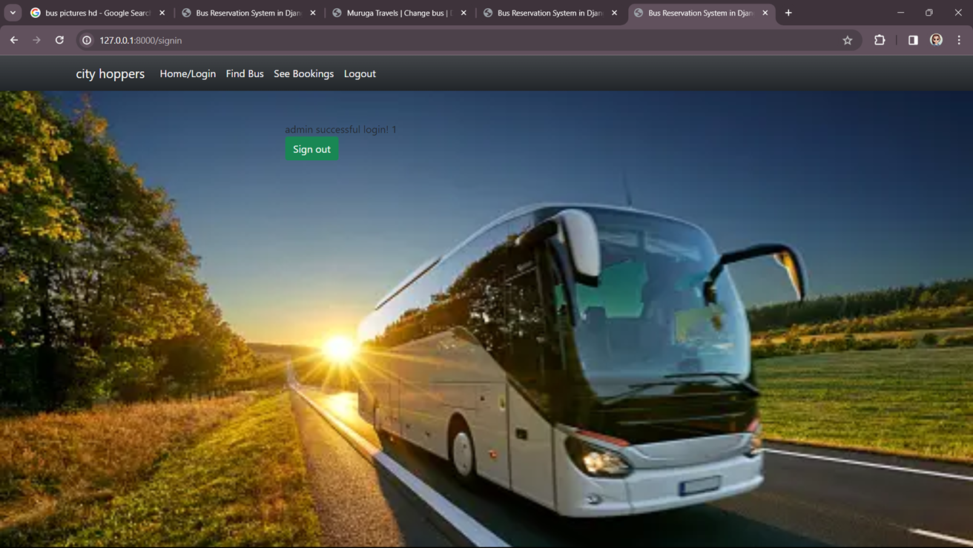
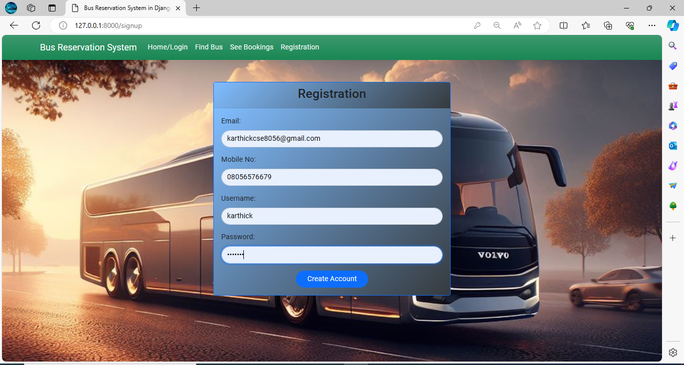
Admin Page

Slide 12
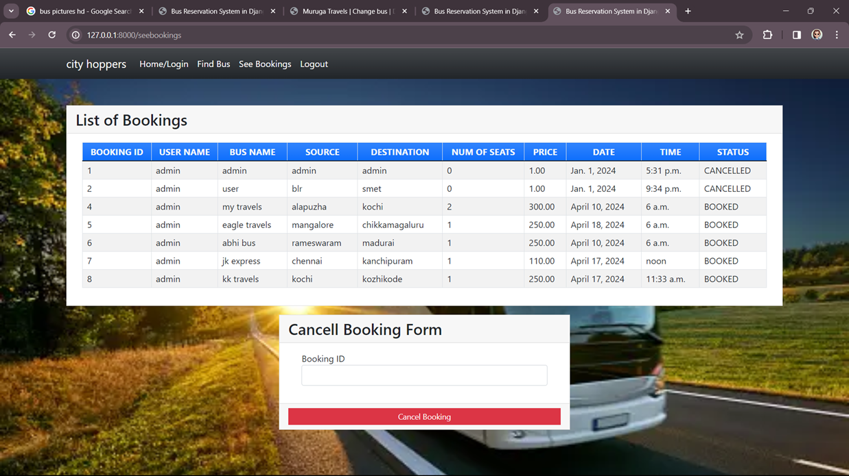
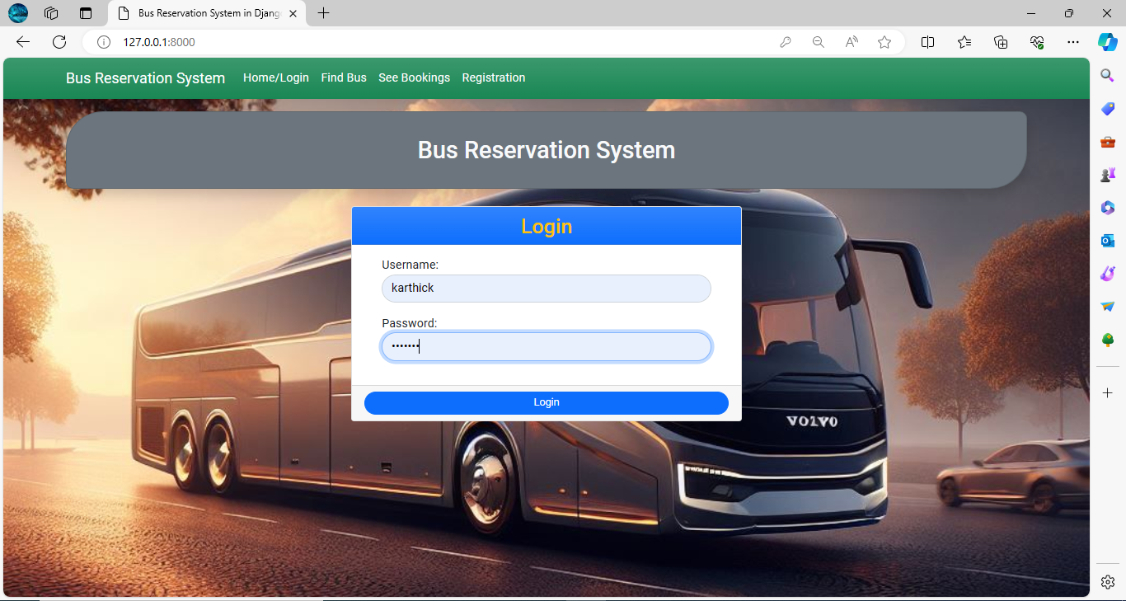
Booking Page

Slide 13
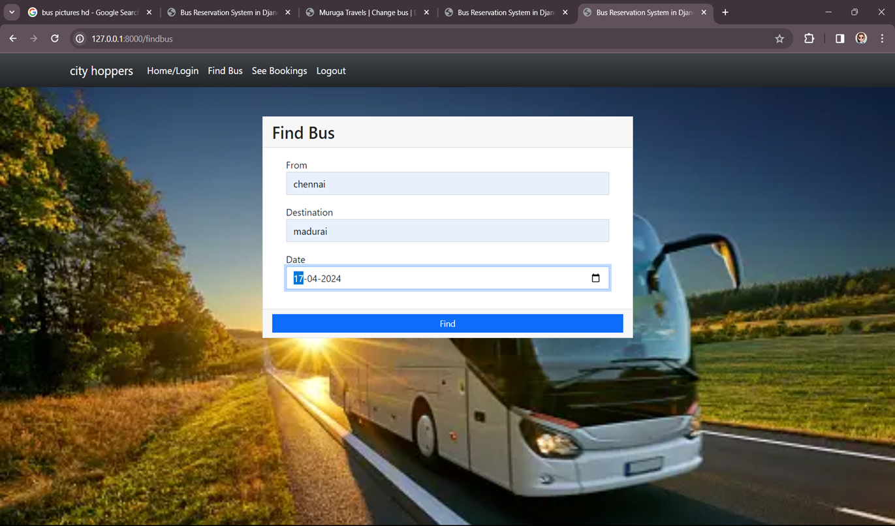
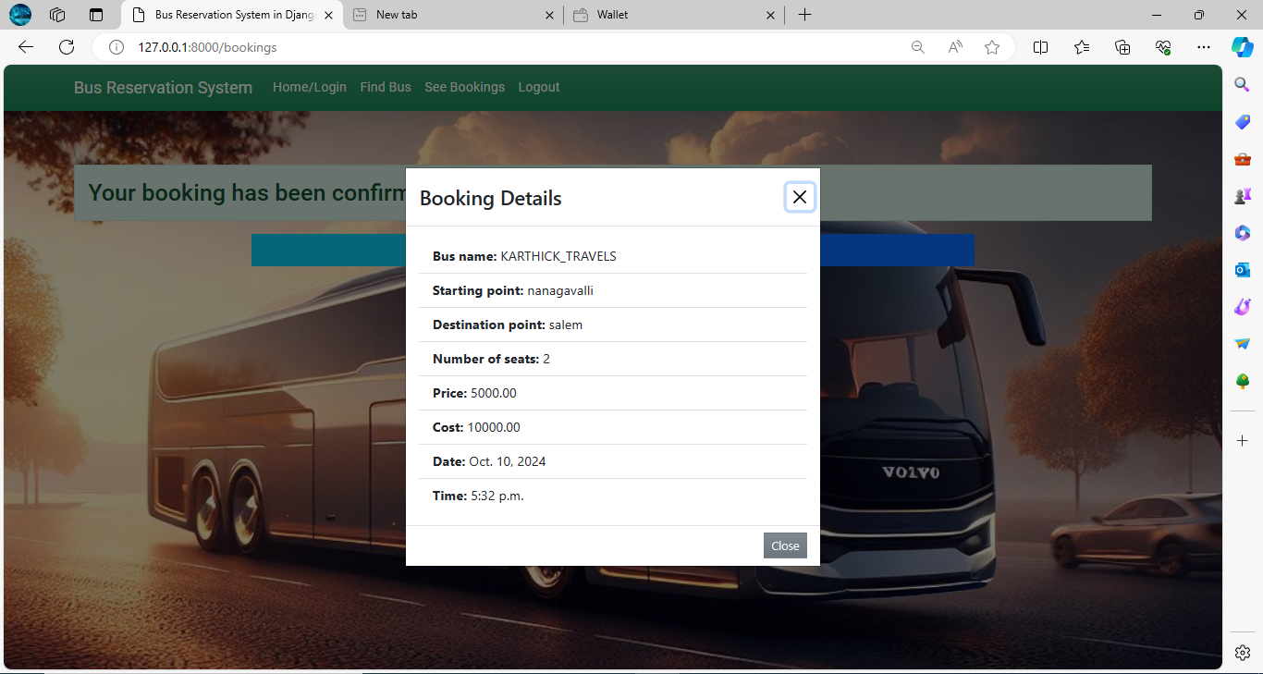
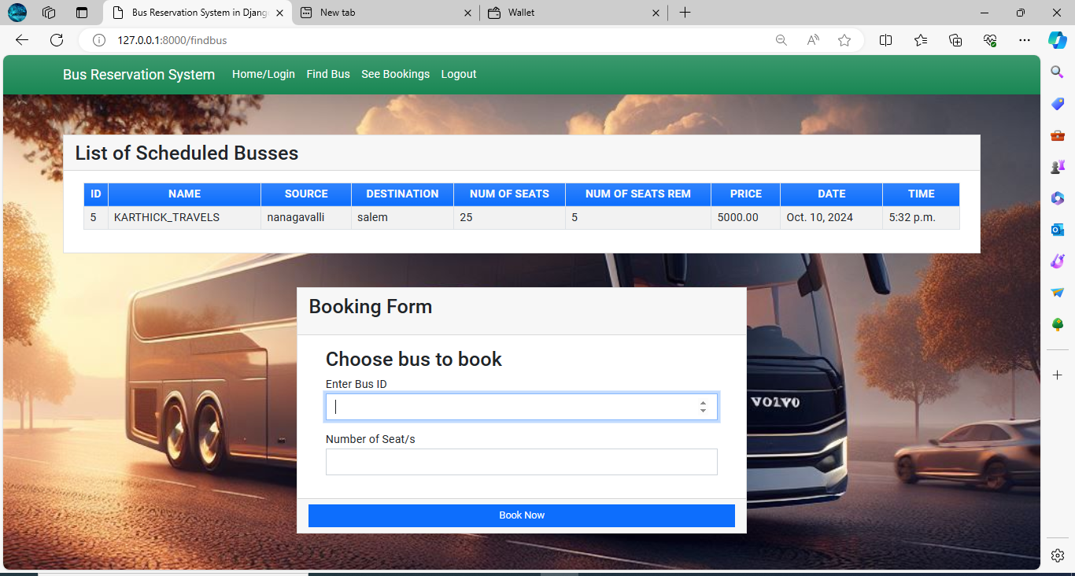
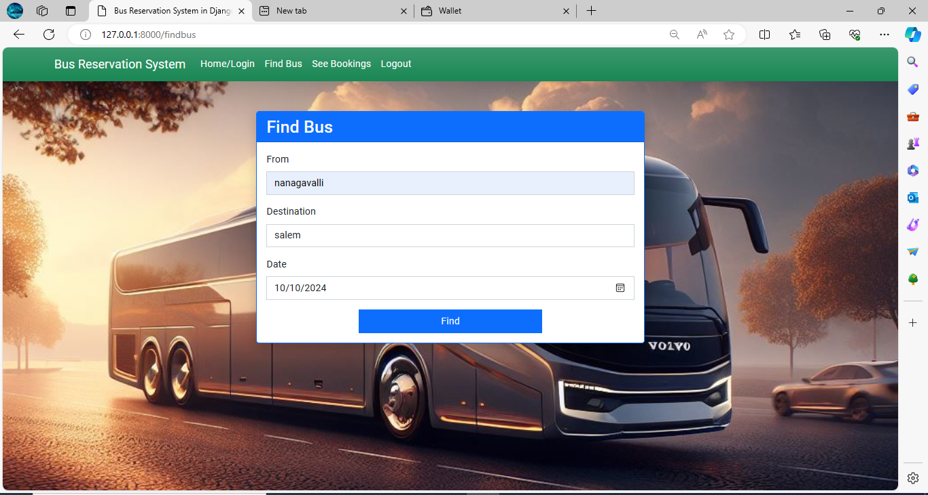
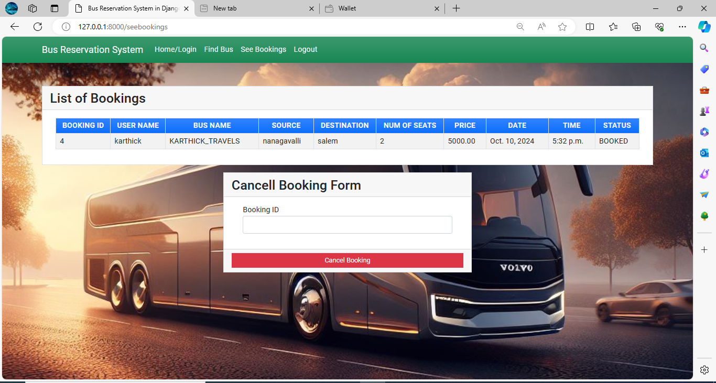

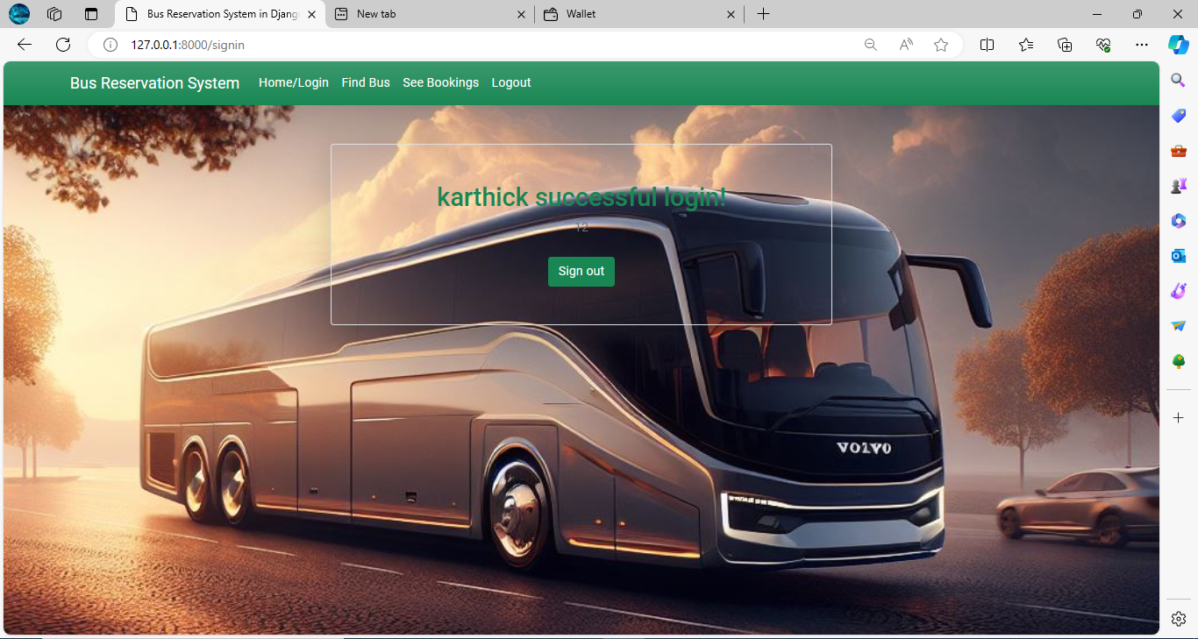
Service-Page

Slide 14
Future Enhancements:
Advanced search filters for buses.
Real-time bus tracking with GPS.
Mobile app development for iOS and Android.
Discounts, promotions, and loyalty rewards.
Feedback and rating system for continuous improvement.
Multi-language support for accessibility.
Integration with external services like hotels and taxis.
Dynamic pricing based on demand and availability.
Social media integration for brand visibility.
Accessibility features for users with disabilities.

Slide 15
Conclusion
The Bus Reservation System project introduces a transformative solution to streamline bus ticketing processes and enhance user experience. With advanced features like real-time tracking and personalized services, it marks a significant advancement in the transportation industry. The outlined future enhancements ensure the system remains adaptable to evolving needs, promising continued innovation and excellence. As we look forward, this project sets a new standard for convenience and efficiency in bus travel, offering users a seamless journey from booking to boarding.
Source :

Slide 16
Thank You!
Notes:
Thank You !!

